Slide 1
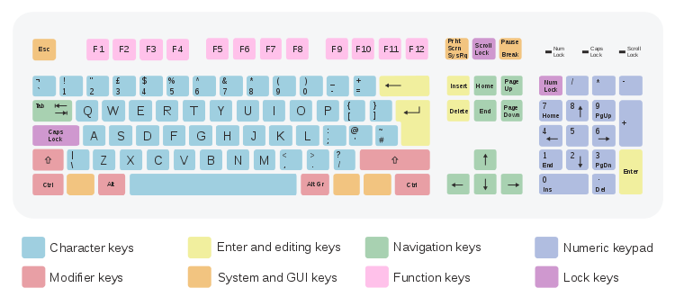
Keyboard:
Keyboard is a device which has several keys to input. It contains Alphabets, Digits, Special Characters and some Control Keys. When a key is pressed, an electronic signal is produced which is detected by an electronic circuit called keyboard encoder. The function of encoder is to detect which key has been pressed and send a binary code for the processing.

Slide 2
Alphanumeric Keys: Alphabetical, numeric and punctuation keys are available on keyboard. Alphanumeric keys are: A to Z, a to z, 0 to 9
Special Symbols Keys: Apart from alphanumeric keys keyboard have some specials keys with special symbols like $, ~, #, %, *, @ etc…
Control Keys: they are generally used along with some short cut keys. Like Ctrl + C for copy, Ctrl + X for cut etc… we usually use Ctrl, Shift and Alt key.
Function Key: Function keys have inbuilt functions which are already provided. For example F1 is assigned for HELP.
Navigation Key: There are 4 navigation keys in keyboard with the Arrow symbols. Like →, ←, Other navigation keys are HOME, END, TAB, PAGEUP, PAGEDOWN Etc…
Special Keys: These keys are available on special types of keyboard. For example, If you buy multimedia keyboard, you will have volume up and down button on the keyboard.

Slide 3
Mouse
A mouse is a device that controls the movement of the cursor or pointer on a display screen. A mouse is a small object you can roll along a hard, flat surface. A mouse is also called Pointing Device. The first mouse was invented by Douglas Engelbart of Stanford Research Center in 1963. Some common functions of mouse can be discussed as follows:
Pointing: This is probably the main use of mouse. You can move mouse along your screen in order to point out any object i.e. any part of the screen.
Clicking: You first move your mouse pointer on particular object and then press the mouse button and release it. This action is considered as Clicking.
Double Clicking: Once you click on mouse TWICE immediately on after another, it’s called Double Clicking.
Moving: Mouse can be used to move any object by just clicking and holding on it.
Dragging: When we need to transfer any file from one folder to another folder, we need to drag that file. If we select some object on screen and then move the mouse by pressing left button which moves the object along with mouse is called Dragging.

Slide 4
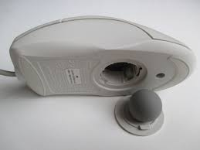
Types of Mouse
Mechanical Mouse

Slide 5
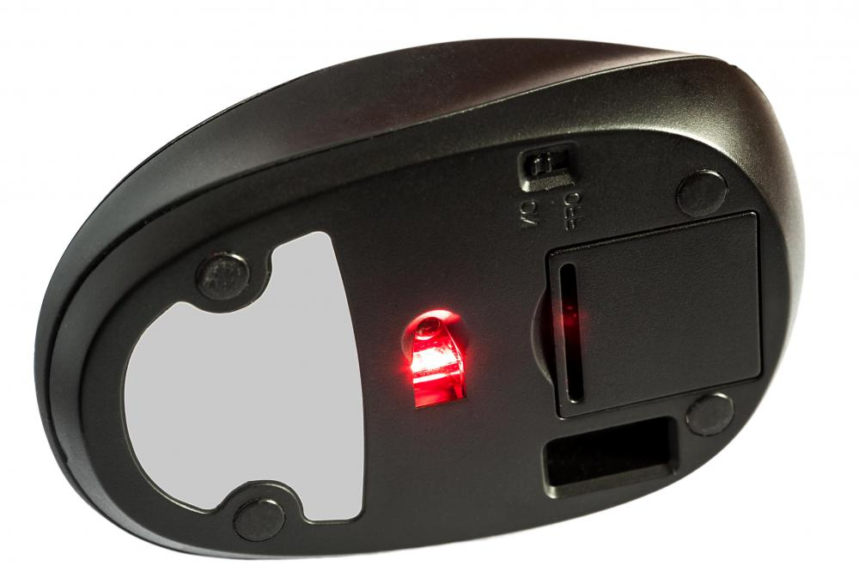
Optical Mouse

Slide 6
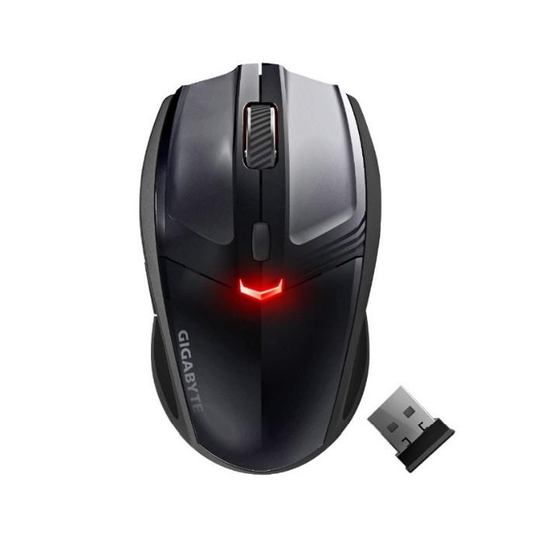
Laser Mouse

Slide 7
Other Mouse Types
Cordless Mouse
Gyroscopic Mouse
3D Mouse

Slide 8
Trackball
A track ball is a pointing device consisting of a ball held by a socket containing sensors to detect a rotation of the ball. The user rolls the ball with the thumb, fingers or the palm of the hand to move a pointer. Buttons on the trackball can be a single click, right click, double click or drag lock.

Slide 9
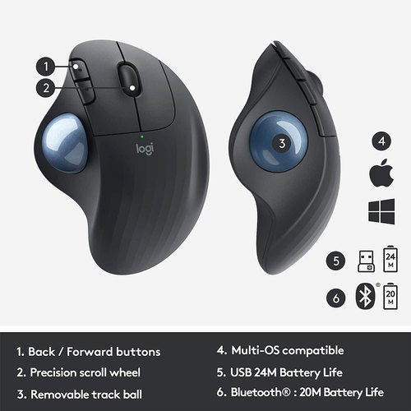
Trackball with Mouse

Slide 10
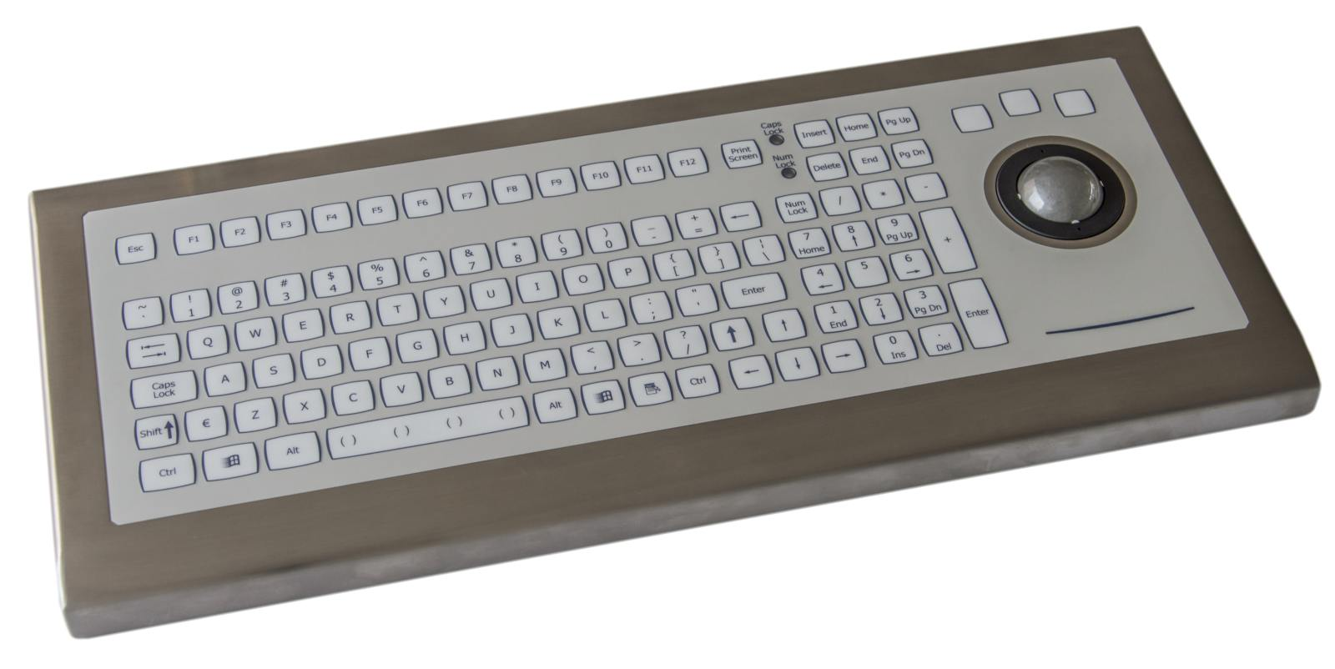
Trackball with Keyboard

Slide 11
TOUCH SCREEN
A touch screen enables the users to choose from available options by simply touching their finger to the desired icon or menu item displayed on the computers screen.
Mainly there are two types of touch screens.
1. Resistive Touch Screen,
2. Capacitive Touch Screen.

Slide 12
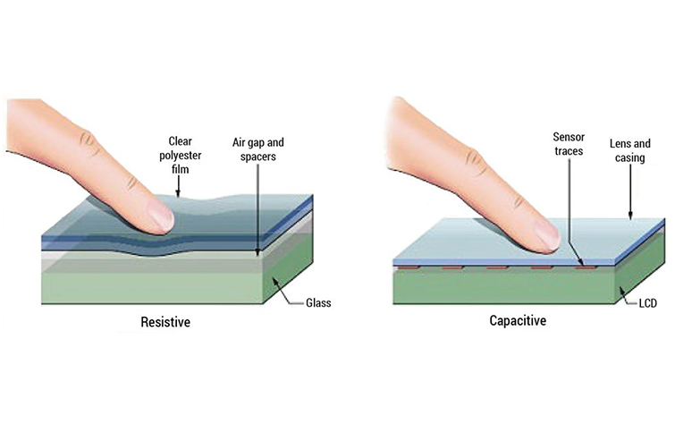

Slide 13
Resistive Touch Screen:
These are the most basic and common touch screens, the ones used at ATMs or in supermarkets. These screens literally “resist” your touch; if you press hard enough you can feel the screen bend slightly. Two electrically conductive layers bending to touch one another.

Slide 14
Capacitive Touch Screen:
Unlike resistive touch screens, capacitive screens do not use the pressure of your finger to create a change in the flow of electricity. Instead, they work with anything that holds an electrical charge including human skin. Capacitive touch screens are constructed from materials like copper or indium tin oxide that store electrical charges in an electrostatic grid of tiny wires, each smaller that human hair.

Slide 15
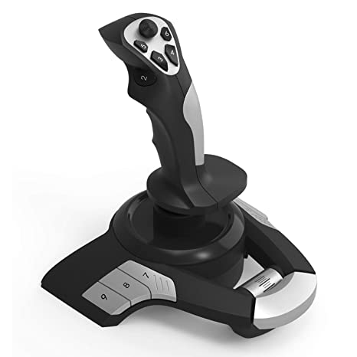
Joystick:
A joystick is also a pointing device. It is used to move the cursor position on a CRT screen. Its function is similar to that of a mouse. It is a stick, which has spherical ball at its lower-end as well as at its upper-end. The lower spherical ball moves a socket. The joystick can be moved left or right, forward and backward. Joystick is mainly used for playing 3D games.

Slide 16
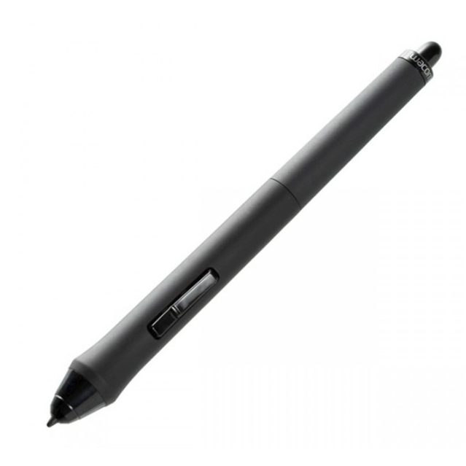
Light pen
Light Pen: A light pen is a pointing device. It is used to select and write the text on the monitor. It is a photosensitive pen like device. It is capable of sensing a position on the screen when its tip touches the screen. When its tip is moved over the screen surface, its photocell sensing element detects the light coming from the screen and the corresponding signals are sent to the processor.

Slide 17
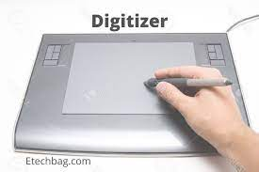
Digitizer
Digitizer is an input device used for converting (digitizing) pictures, maps and drawings into digital form and store in computer.
It is commonly used by architects and engineers to design cars, buildings, medical devices etc…

Slide 18
SCANNERS
Scanner: scanners are capable of entering information directly into the computer. By using the scanner we can convert printed material into soft copy. There is variety of scanners available in the market. Depending on the usage.

Slide 19
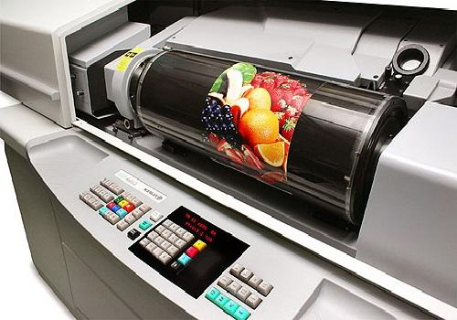
Drum Scanner
drum scanners are bigger in size which is used to scan high resolution images. Drum scanners capture image information using Photo Multiplier Tubes (PMT) Technology. Xerox machine can be categorized somewhat similar to a Drum Scanner which scans the image and transfers the control to the digital circuit which prints the scanned image through Drum Scanner.

